Slide 1


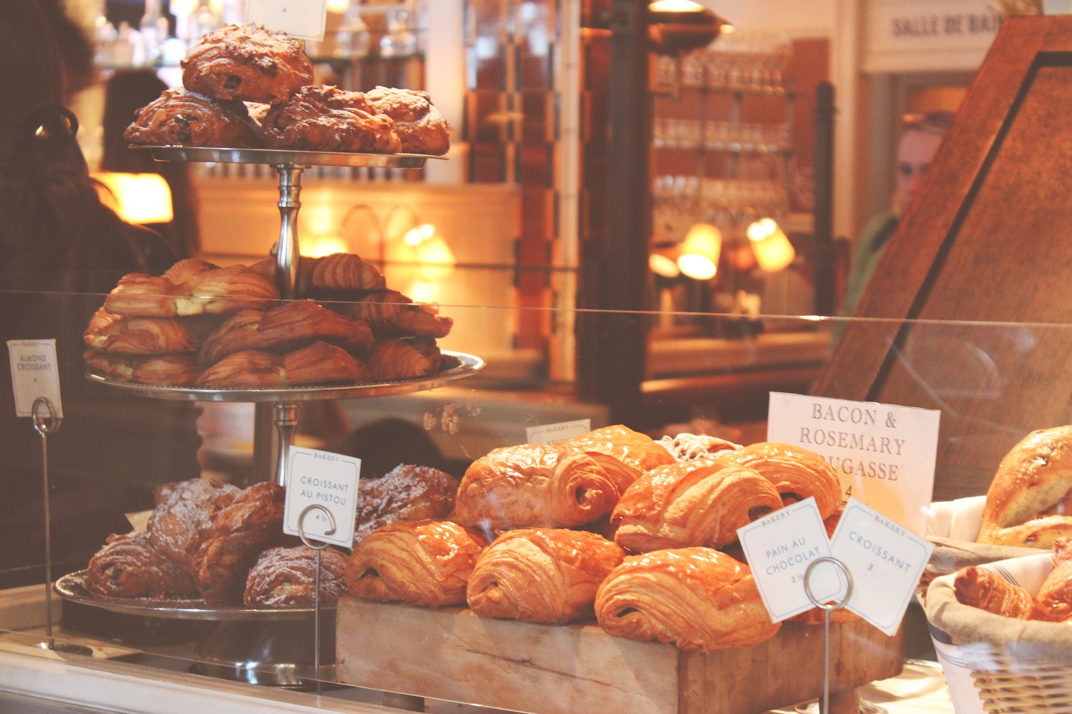

Spanish Bakery in Data

Slide 2
Real Data from a Real Business
Prices changed to protect business details

Slide 3
Get to Know your Data!
Sales Data: Quantities, Sales Values, Taxes, Categories of products
9275 Rows of data
Row represents one item as part of a sale
Sales spanning: From 2021-MAY-30 to 2022-MARCH-09
Let’s do some exploring…

Slide 4
Basics
Value of total sales: €40,095
Value of sales taxes: €2,550
Sales - tax: €37,545
How many items sold? 10,334
How many sales? 5756
How many returns? 149

Slide 5
Most popular Items? Number of items sold by category
“Magdalenas dulces”
Chocolate 1331
Pistacho 1262
Naturale 1081
Praline 965
Magdalenas dulces 6737
Patisserie 830
Magdalenas saladas 254
Bebidas 56
*Discrepancy from previous 10k items sold!
…some items are not categorised.
These items seem to be Magdelenas bundle packs.

Slide 6
Stats per Sale Stats per Day
Average sale Value: €6.96
Max sale: €145
Median: €5.8
25% value €2.91
75% value €8.90
Average daily sales: €217
Max daily sales: €790
Median: €198
25% value €111
75% value €280
€790 day was attributed to one huge sale. Is an outlier, but a valid sale too!

Slide 7
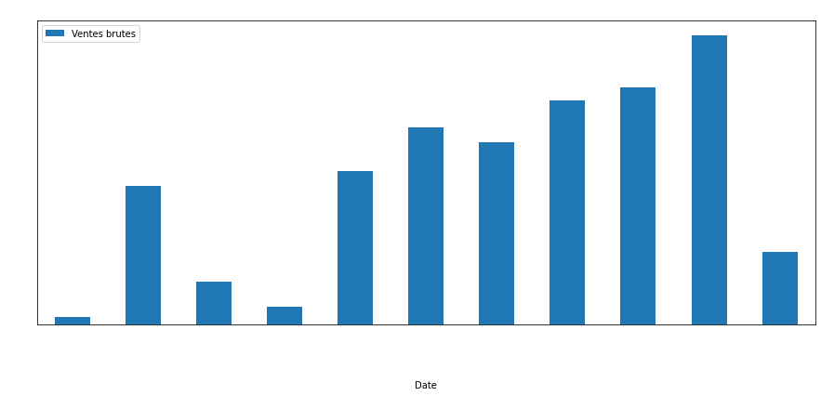
Monthly Sales (€)

Slide 8
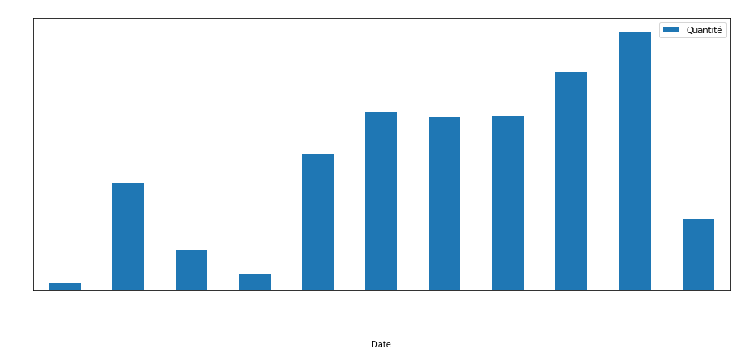
Monthly Items Sold

Slide 9
Monthly Data Insights
Significant decreases in March, May, July & August.
Did they close?
Was there covid restrictions?
Supply crisis?
Data set is real but no client contact. Have no insight into how the business operates
Potentially can investigate this as the sales time granulates down to the minute
Data for May starts at the end of the month - reason for lower May sales
Data for March ends on the 9th - reason for a lower March sales
Generally, sales trend is increasing which means… Keep doing what you’re doing!

Slide 10
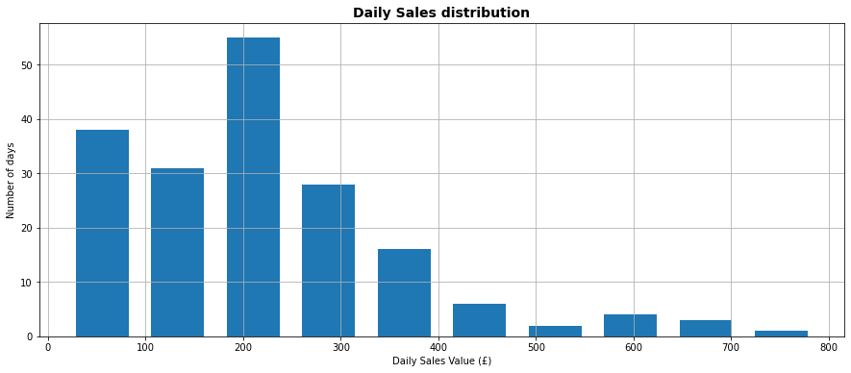
Distribution of Daily Sales Value

Slide 11
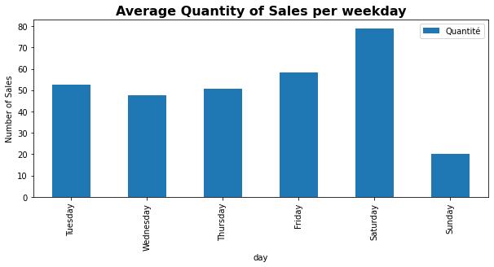
Busiest Day of the Week? (across entire data range)

Slide 12
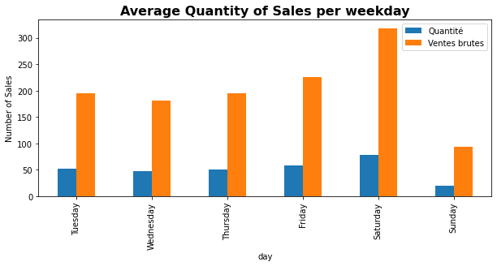
Busiest Day of the Week? Including Gross Sales

Slide 13
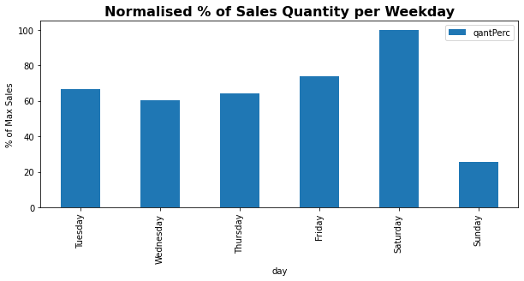
Busiest Day of the Week? Relative to Maximum

Slide 14
Insights
Most frequently have ~€210 daily sales
Dynamic operating: could close after making high 200’s as it’s less likely to make more.
Busiest & most profitable day : Saturday, by a significant amount
Sunday is the least busy or profitable day: 75% less sales compared to Saturday
Is there a reason? Could this be improved?
If not…. Could close on Sunday without losing too many sales!

Slide 15
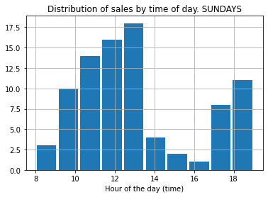
Investigate Sunday Sales
Data shows they are open all day Sundays
Data is the sum of all Sunday sales.
Therefore there was ~11 sales after 6pm for the whole year.
Closing after 2pm would cost the business 22 sales per year.
Could advertise Sunday openings to boost sales,
or close and get your sundays back!

Slide 16
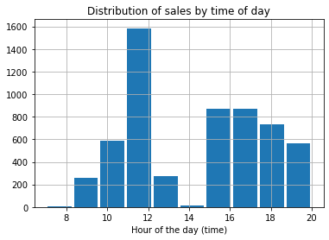
Busiest Time of Day: hourly distribution (all sales)

Slide 17
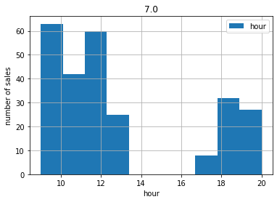
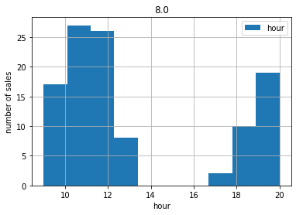
Busiest Time of Day: hourly distribution
July
August

Slide 18
insights
Compared to other months, July and August:
Have sales in extended opening hours - until 8pm!
Show no sales between 2pm and 4pm: indicating they may be closed! Spanish Siesta!
General lower sales number than other months. Significantly lower!
Is this the chicken or egg?
We don’t know. Would now talk to the client to ask operational questions
If you closed completely for July & August you would lose:
€1,553.71 or
3.88% of the datasets’s sales
Extended opening hours in July & August do not appear worthwhile
Consider product changes in summertime. Sell Ice creams perhaps

Slide 19
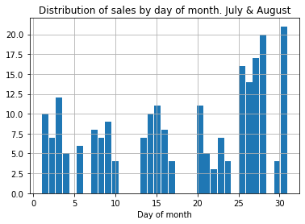
Check distribution of sales by day of month- July & August
Investigation into daily openings.
Open most but not all days in july and August.
Could be Spanish public holidays
Still not the complete answer as July & August sales are ~4x less than adjacent months june & september.
Discussion with client required.

Slide 20
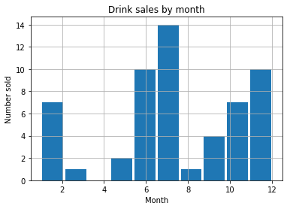
Drink Sales Analysis: Distribution by month

Slide 21
Drink Sales
Max drinks sales occurred in July (UK summer!) : 14 sold… this is not many.
July had 257 overall sales, 14 drinks sold.
This seems odd, as cold drinks are offered for sale. Further investigation point.

Slide 22
Closing statements
Business is doing well! Sales trend is increasing well over time.
Consider business reasons why sales are 4 times less in July/August.
Consider closing in July/August for life balance :).
Conversely consider offering more summer products in July / August.
Very minimal drinks were sold. Question why, or the drinks setup.
Coffee is not sold? Missing a trick here!

Slide 23
Remarks
This data was sourced from an “Upwork” job.
I didn’t get the Upwork job, but I did the analysis anyway.
Price data was changed by a factor to make it different to original data.

